Slide 1
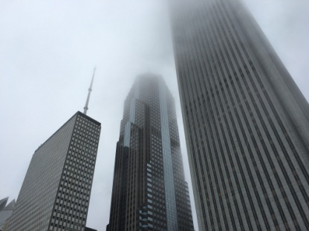
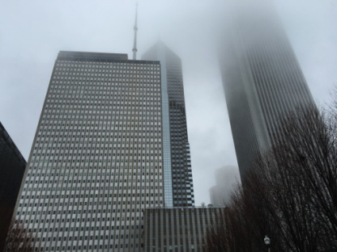
Grey #A9A9A9
Grey
MEANS…
1)Formality
2)Moody color
3)Sad/Depressing
Avni Avdulla
SONG
Redemption by Drake because this song has a slow and moody vibe.
WHEN I’M Grey I…
am monotone. I feel good but don’t show it. I feel professional, like I just got a really important job. I feel strong and able to do what I want. I feel in control. Grey has a lot of meaning behind it, and it’s not all bad. Grey is a strong and bold color.
COMPLEMENATRY COLORS (with hex)
1)Navy Blue #0b0b49
2)Purple #4f0f60
Almost all colors go with grey so I picked ones that I like

